Slide 1
Agri-Support: Llama2 Based Agriculture Language chat model with ML prediction for Optimal Crop Yield
Review – 1
Rahul Sandireddy – (20BCE1001)
Submitted To
Dr. Vergin Raja Sarobin M

Slide 2
1. INTRODUCTION
Area of the Project

Slide 3
INTRODUCTION
Agriculture LLM and Crop Yield Prediction
Addressing the multifaceted challenges faced by farmers in agriculture, the key issues encompass weather uncertainties, plant protection, animal husbandry, market prices, fertilizer usage, and awareness of government schemes. The central research questions works on: "How can an Agri-Bot model effectively assist farmers in navigating and finding solutions to these challenges, and how can an ML model be utilized for predicting crop yield?“

Slide 4
Background of Study
Agriculture is a vital sector contributing significantly to the global economy. As technological advancements continue to reshape various industries, the integration of artificial intelligence (AI) and machine learning (ML) in agriculture has become imperative for optimizing processes and increasing productivity. This project focuses on the development of an Agriculture LLM (Llama-7b-chat) chatbot model, fine-tuned using LoRA (Llama-7b Regulator Algorithm), and incorporates regression models for crop yield prediction.

Slide 5
2.Literature Review

Slide 6
Themes Discovered in Review
Advancements in Large Language Models (LLMs): The introduction of Llama-2 and its family of models, as discussed in [1], showcases the progress in large language models. The exploration of the Tamil language in LLaMA [2] and the unified text-to-text transformer approach [3] further underscores the evolution of language models.
Adaptation Techniques for LLMs: The Low-Rank Adaptation (LORA) strategy [4] provides insights into efficient adaptation of LLMs to specific tasks, contributing to the broader understanding of model adaptation techniques.
Domain-Specific Chatbots: The application of LLMs for domain-specific chatbots, as exemplified in science-related chatbots [5], aligns with the goals of the Agri-Bot model, showcasing the versatility of LLMs in specialized contexts.
Reinforcement Learning and Fine-Tuning: Papers such as [6] and [1] delve into the use of reinforcement learning and human feedback for fine-tuning LLMs. These methodologies contribute to the understanding of model optimization.

Slide 7
Deep Learning in Agriculture: Several papers ([7], [8], [9]) emphasize the integration of deep learning and data analytics in agriculture, indicating the broader trend of leveraging advanced technologies in the agricultural domain.
Machine Learning for Crop Yield Forecasting: The exploration of machine learning for crop yield forecasting ([10], [12]) highlights the increasing role of predictive modeling in agricultural practices.
Proximal Sensing and Machine Learning: The incorporation of proximal sensing technologies with machine learning ([13], [14]) reveals the growing interest in utilizing diverse data sources for precise crop yield predictions.
Precision Agriculture and Technology Adoption: Literature ([11], [15]) underscores the significance of precision agriculture, emphasizing the role of technologies like remote sensing, drones, and IoT devices. The study on farmers' perceptions [15] bridges the gap in understanding technology adoption in agriculture.

Slide 8
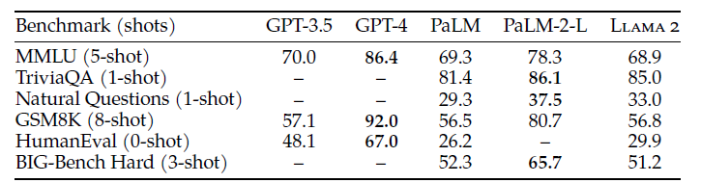
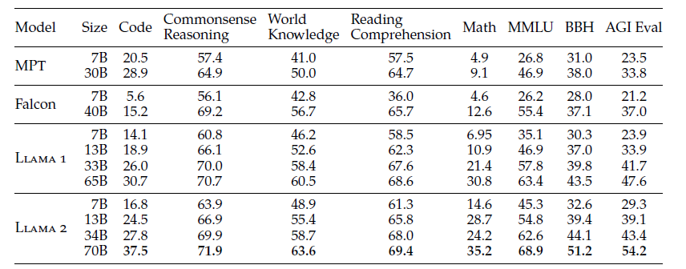
Comparison to closed-source models on academic benchmarks.
Comparison to open-source models on academic benchmarks

Slide 9
Literature Review
[1]. Llama 2: Pretraining and Fine-Tuning High-Performance Dialogue Models introduces the Llama 2 family of Large Language Models (LLMs). The authors highlight improvements in their pretraining methodology, including robust data cleaning, a 40% larger training corpus, and the adoption of grouped-query attention. They release Llama 2 and Llama 2-Chat models at scales up to 70B parameters, reporting superior performance on helpfulness and safety benchmarks compared to existing open-source models. The fine-tuning process involves supervised fine-tuning and Reinforcement Learning with Human Feedback (RLHF), with safety-specific data annotation and tuning. The authors emphasize responsible release, providing a guide for safe deployment and open-sourcing the models for research and commercial use. Additionally, the paper introduces Ghost Attention (GAtt) to address multi-turn dialogue consistency issues, demonstrating its effectiveness in controlling dialogue flow.

Slide 10
[2] This paper contributes significantly to the field of language modeling by addressing the underrepresentation of Tamil in large language models. The integration of 16,000 Tamil tokens into the LLaMA model, coupled with the innovative LoRA methodology for efficient training, results in notable advancements in text generation capabilities. The introduction of a translated Alpaca dataset and OpenOrca subset tailored for instruction fine-tuning further enhances model performance. The evaluation methodology, combining GPT-4 scoring and manual reviews, establishes a robust framework for assessing the Tamil LLaMA models. Despite inherent limitations, such as ethical concerns and translation loss, the work provides a foundational step towards improving language models for Indian languages.
[3] Transfer Learning with a Unified Text-to-Text Transformer introduces a novel approach to natural language processing tasks. Published by Google Research in 2019, the paper proposes a unified framework where diverse NLP tasks are cast into a text-to-text format, enabling a single transformer model to handle a wide range of tasks without task-specific modifications. The authors showcase the effectiveness of T5 on tasks such as translation, summarization, and question answering, achieving state-of-the-art results across multiple benchmarks. The unified text-to-text formulation simplifies model training and deployment, making T5 a powerful and versatile LLM in the field of NLP

Slide 11
[4] LORA: Low-Rank Adaptation of Large Language Models explores an innovative approach to adapting large language models (LLMs) to specific tasks. Published by researchers, LORA focuses on low-rank factorization of model parameters to achieve efficient adaptation. This method reduces the number of updated parameters, allowing faster adaptation with limited task-specific data while mitigating the risk of overfitting. The authors demonstrate the effectiveness of LORA across various natural language processing tasks, highlighting its computational efficiency and superior performance compared to traditional fine-tuning methods. The low-rank adaptation strategy proposed in the paper addresses the challenge of adapting LLMs to new tasks in a resource-efficient and effective manner.
[5] This paper explores the rapid advancement of artificial intelligence and machine learning, particularly in the context of large language models (LLMs). It highlights the convergence of generative AI, exemplified by models like the generative pre-trained transformer (GPT), with LLMs trained on vast datasets for tasks such as sentiment analysis, code completion, and interactive chatbots. The authors discuss the success of reinforcement learning using human feedback (RLHF) in tailoring LLMs, leading to high-quality chatbots like ChatGPT. The paper recognizes the potential application of these capabilities in accelerating research in the physical sciences, proposing methods such as training LLMs on scientific publications or fine-tuning existing models for domain-specific data.

Slide 12
[6] It introduces a novel approach called Reinforcement Learning from Human Feedback (RLHF) and aims to fine-tune an LLM in the field of psychology. The study presents the theoretical foundations of LLMs and RLHF, discusses ethical considerations in developing a psychological AI, and reviews previous research in RLHF and AI in psychology. The method involves training and evaluating the model using a dataset from Counsel Chat
[7] The proposed paper introduces AgriMine, a framework for analyzing more than 26 million farmers' helpline call records in India. It addresses the crucial need for accurate information on agricultural issues by employing spatial mapping, time series analysis, and deep learning models. The study leverages data collected through the Kisan Call Centres, revealing hidden patterns in crop-wise density and temporal dynamics of farmers seeking help. The framework employs innovative approaches like step-plots and forecasting models to predict topic-wise demand for assistance. The methodology includes data collection, pre-processing, spatial and temporal analysis, and showcases its utility through case studies, emphasizing artificial intelligence, data analytics, and decision-making in agriculture.
[8] In this paper emphasizes the underexplored potential of conversational agents in addressing the information needs of farmers in the agricultural domain. It notes a scarcity of existing systems despite research indicating significant possibilities. The review identifies key categories of information needs in agriculture, such as crop protection, best practices, markets, and climate, shedding light on the importance of contextualization and personalization

Slide 13
[9] The paper addresses the pressing issue of low income among Indian farmers due to limited access to information about government schemes, farming practices, and resources. Recognizing the challenges faced by smallholders in remote areas, the paper proposes an intelligent chatbot, named Agroxpert, utilizing natural language processing to assist farmers in making informed decisions on crop selection and farming methods. The study emphasizes the significance of technology in overcoming barriers to agricultural knowledge dissemination and highlights the role of the proposed chatbot in enhancing farmer awareness and productivity.
[10] Machine learning for large-scale crop yield forecasting" delves into the application of machine learning techniques for comprehensive crop yield forecasting within agricultural systems. Addressing the imperative need for accurate predictions in large-scale agricultural contexts, the study explores the potential of machine learning to enhance the precision and scalability of crop yield forecasts. The literature review underscores the significance of advanced technologies, emphasizing the potential of machine learning models to revolutionize traditional approaches to crop yield prediction.

Slide 14
[11] The literature survey on the future of precision agriculture in India reveals a growing body of research emphasizing the pivotal role of advanced technologies such as remote sensing, drones, and Internet of Things (IoT) devices in optimizing agricultural practices. Studies highlight the potential of precision farming to enhance resource efficiency, crop yield, and overall farm productivity. Additionally, the integration of machine learning algorithms and data analytics in precision agriculture emerges as a significant trend, offering insights into predictive modeling for crop management and decision support systems. Scholars emphasize the need for comprehensive adoption frameworks and policy support to facilitate the widespread implementation of precision farming techniques in the Indian agricultural landscape
[12] Crop Yield Prediction Using Deep Reinforcement Learning Model for Sustainable Agrarian Applications, existing research emphasizes the adoption of advanced computational methods, specifically deep reinforcement learning, for accurate and dynamic crop yield predictions. Scholars highlight the potential of reinforcement learning algorithms to capture complex relationships between various environmental factors and crop outcomes, thereby offering a more robust and adaptive approach compared to traditional models. Previous studies have explored the integration of satellite imagery, climate data, and soil information in conjunction with deep reinforcement learning to enhance prediction accuracy. Furthermore, the survey underscores the significance of leveraging historical crop data and sensor-based technologies to train and optimize the deep learning models, contributing to the development of sustainable agrarian practices through informed decision-making. The literature review also calls attention to the need for scalable and interpretable models to facilitate widespread implementation in diverse agricultural settings.

Slide 15
[13] Crop Yield Prediction through Proximal Sensing and Machine Learning Algorithms" reveals a growing interest in the integration of proximal sensing technologies and machine learning methods for accurate and timely crop yield predictions. Researchers highlight the significance of proximal sensing techniques such as satellite and drone imagery, as well as ground-based sensors, in capturing detailed spatial and temporal information crucial for crop monitoring. Studies underscore the effectiveness of diverse machine learning algorithms, including regression models, support vector machines, and neural networks, in analyzing proximal sensing data to predict crop yields. The survey emphasizes the importance of data fusion from multiple sources to enhance prediction accuracy and addresses challenges related to data variability and model generalization. Additionally, scholars emphasize the need for continuous advancements in both proximal sensing technologies and machine learning techniques to foster sustainable and precise agricultural practices.
[14] the utilization of machine learning algorithms and satellite images for crop yield prediction is explored, underscoring the potential of integrating advanced technologies in agriculture. The study contributes to the growing body of literature focusing on the intersection of data science and precision farming, showcasing the relevance of satellite imagery in enhancing predictive modeling. Existing literature has emphasized the importance of accurate yield predictions for informed decision-making in agro-industries. Sharifi's work aligns with previous findings, highlighting the significance of harnessing machine learning techniques to analyze diverse datasets, thus providing valuable insights for sustainable agricultural practices. This research adds to the discourse on the practical application of technology-driven solutions for optimizing crop yield forecasting

Slide 16
[15] Chuang, Wang, and Liou's (2020) investigation into farmers' knowledge, attitude, and adoption of smart agriculture technology in Taiwan presents valuable insights into the human dimension of technological integration in agriculture. The literature survey indicates a gap in understanding how farmers perceive and engage with smart agriculture technologies, emphasizing the need for studies that bridge this knowledge divide. The researchers employ a mixed-method approach, combining qualitative and quantitative methodologies to comprehensively assess farmers' perspectives. This methodological choice allows for a nuanced exploration of attitudes and adoption factors, providing a holistic understanding that can inform strategies for promoting smart agricultural technologies among farmers.

Slide 17
3. Problem Statement

Slide 18
Problem Statement
Despite technological advancements, farmers often face challenges in decision-making processes related to crop management, resource utilization, and yield prediction. There is a need for a comprehensive solution that integrates conversational AI for providing real-time assistance to farmers, fine-tuned for agriculture-related queries and augmented with regression models to enhance the accuracy of crop yield predictions. Bridging the gap between technology and agriculture is crucial for sustainable and efficient farming practices.

Slide 19
4. Research Challenges

Slide 20
Memory Limitations in Fine-Tuning
Fine-tuning large-language models (LLMs) like Llama 2 7B on a single GPU faces significant memory constraints.
Traditional fine-tuning approaches may not be viable due to their high computational demands and large memory footprints.
If we consider loading the model in fp16 (2 bytes per parameter), we will need around 84 GB of GPU memory, which is not possible on a single A100-40 GB card.

Slide 21
Data Variability:
Agricultural data is highly variable due to factors such as climate, soil conditions, and crop types. Developing a model robust enough to handle this variability is a significant challenge. Also agricultural data is highly variable due to factors such as climate, soil conditions, and crop types. Developing a model robust enough to handle this variability is a significant challenge.
Getting access to latest data of yield production district wise is significant challenge

Slide 22
5. Research Objective

Slide 23
Research Objective
This paper objective is to develop a specialized Agriculture LLM chatbot model utilizing the Llama-7b-chat architecture. This involves the creation of a dedicated language model capable of comprehending and responding to queries specific to the agricultural domain, providing farmers with a customized and contextually relevant conversational experience.
In addition to fine-tuning the chatbot model, the research endeavors to integrate regression models into the application. These regression models are designed specifically for accurate prediction of crop yields. By incorporating data-driven predictive analytics, the chatbot aims to assist farmers in making informed decisions about crop management, resource allocation, and overall farm productivity.

Slide 24
6. Methodology

Slide 25
A. Modules
1. Chatbot Model Module:
Algorithm: Llama-7b-chat architecture for language understanding and response generation.
Functionality: Comprehending and responding to agriculture-specific queries with LoRA fine-tuning.
2. Regression Model Module:
Algorithm: Regression models for crop yield prediction (Multilinear regression, random forests, etc.).
Functionality: Analyzing historical and real-time data to predict crop yields.

Slide 26
3. User Interface Module:
Functionality: Providing a user-friendly interface for farmers to interact with the chatbot.
Tech Stack used is REACT and Flask
4. Data Preprocessing Module:
Functionality: Cleaning and preprocessing diverse datasets from Kisan Call Centre (KCC), IPPC, and Kaggle for model compatibility.
Algorithm: Data cleaning algorithms and normalization techniques.

Slide 27
B. Data Collection Approaches/Strategies:
Utilizing open government datasets ensures a comprehensive and diverse collection of agriculture-related queries, enhancing the model's adaptability.
Accessing the IPPC dataset contributes to the inclusion of international perspectives, broadening the model's knowledge base.
Utilizing statistical analysis and machine learning techniques to extract patterns and insights from the collected datasets.
Employing sentiment analysis to understand the emotions and concerns expressed in the queries.
Implementing regression analysis for crop yield prediction based on historical and real-time data.

Slide 28
7. Proposed System

Slide 29
Proposed System Introduction
Introduction to an REACT and Flask based application integrated with Agriculture LLM chatbot system focusing on personalized query handling and also integrated with ML crop yield prediction, and user-friendly interaction.
The proposed system has a number of potential benefits for farmers. It can help them to improve their yields by providing them with accurate predictions of crop yields. It can also help them to learn how to use a computer, which can give them access to a wider range of information and resources.
Overall, the proposed system is a promising application that has the potential to help farmers improve their livelihoods.

Slide 30
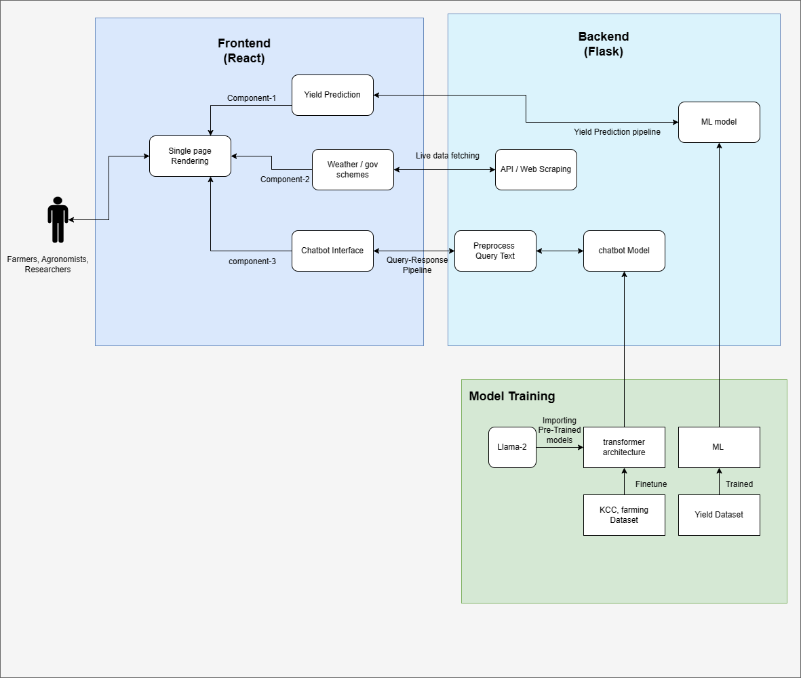

Slide 31
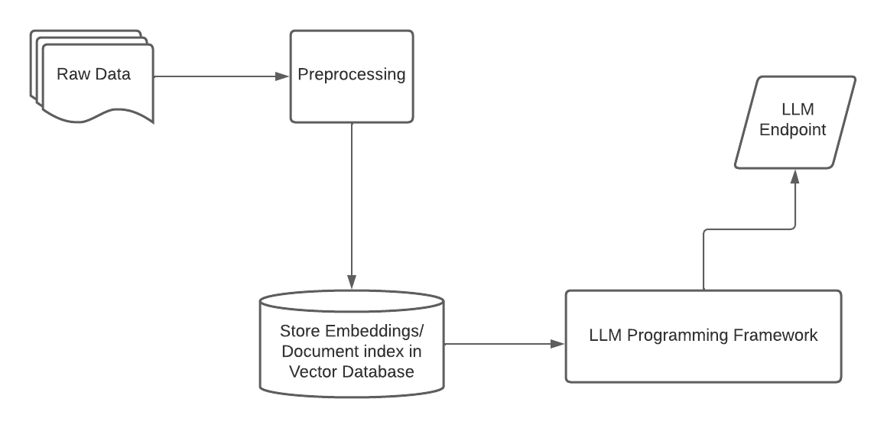

Slide 32
List of modules
1. Data Preprocessing Module
2.Chatbot Model Module
3. Regression Model Module
4. User Interface Module

Slide 33
1. Data Preprocessing Module
The Data Preprocessing Module plays a pivotal role in harmonizing and preparing diverse datasets from sources such as the Kisan Call Centre (KCC), International Plant Protection Convention (IPPC), and Kaggle's Fertilizer Prediction dataset. This module ensures that the data is clean, normalized, and compatible for subsequent analysis and integration into the Agriculture LLM chatbot system.
For yield data Utilizes algorithms to identify and handle missing values, outliers, and inconsistencies in the datasets. Appling techniques such as imputation and normalization to ensure uniformity in data representation.

Slide 34
2. Chatbot Model Module
The chatbot model is built upon the Llama-7b-chat architecture, a variant of large language models specifically fine-tuned for conversational purposes in the agricultural domain.
Leveraging the capabilities of the base Llama-7b model, the chatbot extends its language understanding and generation to address queries related to farming practices, weather conditions, crop management, and other agriculture-specific topics.
The algorithm employed for fine-tuning the base Llama-7b model is Low-Rank Adaptation (LoRA). This technique is chosen for its efficiency in adapting the model's parameters to specific domains while optimizing computational resources.
Unlike traditional fine-tuning approaches that update all parameters, LoRA focuses on optimizing rank decomposition matrices of dense layers. This results in a LoRA adapter, which is fine-tuned and merged with the pre-trained Llama-7b model for enhanced performance.
The key advantage of LoRA lies in its parameter efficiency, reducing the number of trainable parameters and the overall memory footprint.

Slide 35
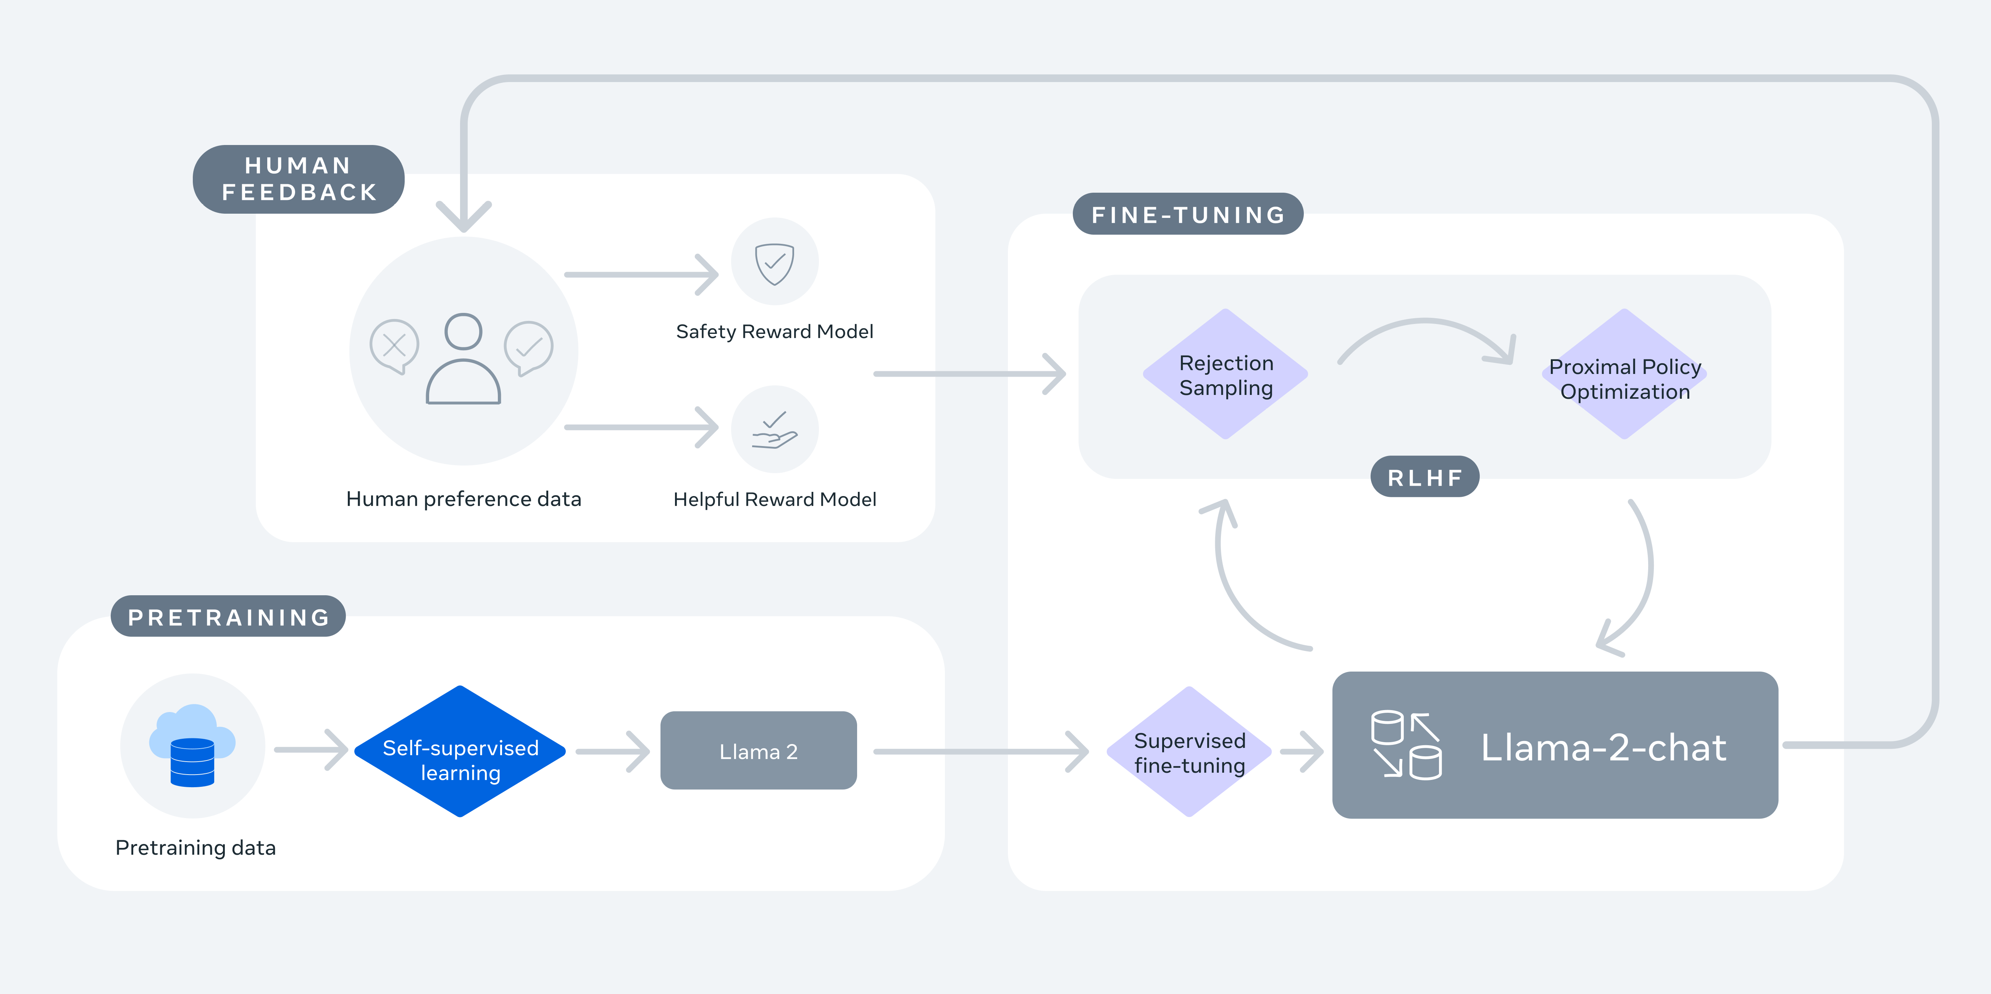

Slide 36
3. Regression Model Module
In the context of predicting crop production based on agricultural data, the Regression Model Modules involve the application of various regression algorithms. Each module represents a distinct regression model, and these models will be applied to the dataset to determine the most effective approach for predicting crop production. Below are explanations of different possible regression models that can be employed in these modules
Decision Tree Regression: Decision trees are capable of capturing complex relationships in the data. This module will utilize decision tree regression to identify non-linear patterns in the input features that influence crop production. Decision trees can handle both numerical and categorical data, making them versatile for agricultural datasets.
Random Forest Regression: Random Forest is an ensemble learning method that builds multiple decision trees and averages their predictions. It reduces overfitting and increases predictive accuracy. This module will explore whether an ensemble of decision trees can enhance the precision of crop production predictions

Slide 37
XGBoost Regression Module: XGBoost is an advanced gradient boosting algorithm that has shown superior performance in various predictive tasks. This module will assess whether XGBoost's ability to handle complex relationships and outliers can lead to improved crop production predictions.
LightGBM Regression Module: LightGBM is a gradient boosting framework designed for efficient training and scalability. This module will explore whether the speed and efficiency of LightGBM contribute to accurate predictions of crop production, especially in scenarios with large and diverse datasets.
CatBoost Regression Module: CatBoost is another gradient boosting library known for its robust handling of categorical features. This module will assess whether CatBoost's specialized capabilities in dealing with categorical variables offer advantages in predicting crop production.
If possible also we can use other different ML models uf possible

Slide 38
4. User Interface Module
The user interface (UI) for the Agriculture LLM Chatbot system is designed to provide a seamless and user-friendly experience for farmers, incorporating React for the frontend and Flask for the backend. This integration aims to deliver personalized query handling, ML crop yield prediction, and an overall intuitive interaction platform.
Technology Stack:
Frontend (React):React is a JavaScript library for building user interfaces, known for its component-based architecture and efficient rendering. It enables the creation of dynamic and responsive UIs.
Backend (Flask):
Introduction: Flask is a lightweight web framework for Python, suitable for building backend APIs. It facilitates the integration of machine learning models and handles communication with the frontend.

Slide 39
8. What is to be done next

Slide 41
9. Research Paper Status

Slide 43
10. Guide Approval mail snapshot

Slide 45
11. References

Slide 46
[1] Touvron, H., Martin, L., Stone, K., Albert, P., Almahairi, A., Babaei, Y., ... & Scialom, T. (2023). Llama 2: Open foundation and fine-tuned chat models. arXiv preprint arXiv:2307.09288.
[2] Balachandran, A. (2023). Tamil-Llama: A New Tamil Language Model Based on Llama 2. arXiv preprint arXiv:2311.05845.
[3] Chung, H. W., Hou, L., Longpre, S., Zoph, B., Tay, Y., Fedus, W., ... & Wei, J. (2022). Scaling instruction-finetuned language models. arXiv preprint arXiv:2210.11416.
[4] Hu, E. J., Shen, Y., Wallis, P., Allen-Zhu, Z., Li, Y., Wang, S., ... & Chen, W. (2021). Lora: Low-rank adaptation of large language models. arXiv preprint arXiv:2106.09685..
[5] Yager, K. G. (2023). Domain-specific chatbots for science using embeddings. Digital Discovery, 2(6), 1850-1861.
[6] Bill, D., & Eriksson, T. (2023). Fine-tuning a LLM using Reinforcement Learning from Human Feedback for a Therapy Chatbot Application.

Slide 47
[7] Godara, S., Toshniwal, D., Parsad, R., Bana, R. S., Singh, D., Bedi, J., ... & Marwaha, S. (2022). AgriMine: A Deep Learning integrated Spatio-temporal analytics framework for diagnosing nationwide agricultural issues using farmers’ helpline data. Computers and Electronics in Agriculture, 201, 107308
[8] Koopman, B., Zuccon, G., Chapman, S., Dang, Y., & Lawrence, D. (2020). How a Conversational Agent Might Help Farmers in the Field. In SIGIR 3th International Workshop on Conversational Approaches to Information Retrieval (CAIR’20).
[9] Nayak, V., & Sowmya, N. H. (2021). Agroxpert-Farmer assistant. Global Transitions Proceedings, 2(2), 506-512.
[10] Paudel, D., Boogaard, H., de Wit, A., Janssen, S., Osinga, S., Pylianidis, C., & Athanasiadis, I. N. (2021). Machine learning for large-scale crop yield forecasting. Agricultural Systems, 187, 103016.
[11] Bhattacharyay, D., Maitra, S., Pine, S., Shankar, T., & Pedda Ghouse Peera, S. K. (2020). Future of precision agriculture in India. Protected Cultivation and Smart Agriculture, 1, 289-299.

Slide 48
[12] Elavarasan, D., & Vincent, P. D. (2020). Crop yield prediction using deep reinforcement learning model for sustainable agrarian applications. IEEE access, 8, 86886-86901.
[13] Abbas, F., Afzaal, H., Farooque, A. A., & Tang, S. (2020). Crop yield prediction through proximal sensing and machine learning algorithms. Agronomy, 10(7), 1046.
[14] Sharifi, A. (2021). Yield prediction with machine learning algorithms and satellite images. Journal of the Science of Food and Agriculture, 101(3), 891-896.
[15] Chuang, J. H., Wang, J. H., & Liou, Y. C. (2020). Farmers’ knowledge, attitude, and adoption of smart agriculture technology in Taiwan. International Journal of Environmental Research and Public Health, 17(19), 7236.

Slide 49
THANK YOU!

